Slide 1
Module 5 - Leading Change
Presented by: [Facilitator Name]
Date: [Session Date]

Slide 2
Module 5 Performance Outcome
Grow: Apply techniques to create the culture of innovation within your sphere that enables you and others to effectively lead and influence customers to the best solutions.

Slide 3
At the conclusion of this module, you will be able to
Identify your spheres of influence
Identify typical challenges you may encounter when working with various stakeholders in those spheres
Plan for influence conversations based on challenges and opportunities in your agency or current digital assignment
Assess your strengths and change style
Develop a personal plan for contributing to and promoting change within your agency and the broader government community

Slide 4
Sprint 1
Leading Change
as an Individual

Slide 5
Preparing for and Having an Influence Conversation

Slide 6
Introduction – Influence in Digital Acquisition
Influence goes beyond formal roles.
Your relationships and networks are key.
Digital procurement leaders drive change through collaboration.
Notes:
Speaker Notes:
In this module, we’re revisiting influence conversations—how to prepare and engage stakeholders to support innovation in digital procurement. As you know, procurement isn’t just about process—it’s about people. Success depends on relationships and your ability to influence across boundaries, especially when introducing new ways of working.

Slide 7
Steps of preparing for an influence conversation
Identify the need or problem for the influence conversation.
Target the range of influencers who can satisfy the need or help solve the problem.
Select those with the greatest leverage.
Prepare for the conversation using the Ladder of Inference.
Notes:
Speaker notes: In this module, you'll revisit how to prepare for an influence conversation by taking a second look at the following steps:

Slide 8
Identifying the Need or Problem
Digital procurement often challenges the status quo.
Common barriers:
Long review processes
Incremental funding
Misaligned metrics
Limited COR capacity
What challenge are you facing?
Notes:
Speaker Notes:
To influence change, you need to clearly identify the challenge or need. Think about your own work—are you encountering outdated oversight policies, under-resourced program staff, or rigid funding structures? Pinpointing the exact issue helps you shape your influence strategy and engage the right people.

Slide 9

Activity: Discussion
What challenge, problem, or need have you experienced as a digital services acquisition leader?

Slide 10
Target the Range of Influencers
Who can help (or hinder) your efforts?
Use your stakeholder analysis to identify:
Decision-makers
Budget controllers
Change agents
Gatekeepers
Notes:
Speaker Notes:
Once you’ve identified the problem, map out who has influence over it. These might be formal leaders like your HCA, or informal influencers with deep organizational knowledge. Think about their roles, authority, and proximity to the issue. Who has the power to help—or to block progress?

Slide 11

Select those with the greatest leverage
Ask:
Who has the most leverage?
What motivates them?
What’s your relationship with them?
Who influences them?
Notes:
Speaker Notes:
You won’t be able to influence everyone at once. Focus on the individuals with the greatest leverage. Consider their power, their goals, and how close you are to them—or to those who influence them. Targeting the right person first can shift the momentum in your favor.

Slide 12
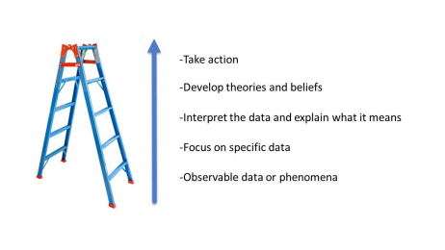
Use the Ladder of Inference
Prepare for the conversation:
Observable facts
Specific data
Interpret the data
Assumptions
Actions
Notes:
Speaker Notes:
Now that you’ve identified your influencer, it’s time to prepare for the conversation. The Ladder of Inference helps you understand how people form beliefs and take action—often based on assumptions. Use this tool to anticipate their perspective and challenge your own. Meet them where they are, and guide them toward a shared solution.

Slide 13
Strategies to Move Forward
Find common ground
Share success stories
Propose alternatives
Use data
Collaborate
Pilot approach
Notes:
Speaker Notes:
If you expect resistance, be ready with practical strategies. Share examples. Offer modified solutions. Use data to make your case. And remember—you’re not alone. Invite them to co-create a solution. By doing so, you position yourself not just as a leader, but as a trusted partner in change.

Slide 14
Difficult Conversations

Slide 15
Navigating Difficult Conversations
Conversations don’t always go as planned.
Difficult topics are part of digital service leadership.
This module will help you:
Approach hard conversations constructively
React to conflict with useful tactics
Recognize misalignments between acquisition and Agile
Notes:
Speaker Notes:
Welcome to this module on difficult conversations. You’ve already practiced preparing for influence conversations, but what happens when things don’t go as planned? Whether it’s delivering tough news or persuading a peer, these moments require skill. Our goal today is to equip you with tools and strategies to approach hard conversations with clarity, compassion, and effectiveness.

Slide 16
Why Conversations Get Difficult
Assumptions and misunderstandings
Blame and fear of conflict
Emotional stakes and self-identity
Role of hierarchy in defensiveness
Notes:
Speaker Notes: Conversations often become difficult when there's a clash of perspectives, assumptions, or expectations. Sometimes, it’s not even about the issue—it’s about identity, emotion, or fear of being blamed. When we feel our competence or values are under threat, we tend to react strongly. Understanding these dynamics helps us respond thoughtfully instead of defensively.
Discussion Prompt: What causes YOU the most stress in tough conversations—fear of conflict, fear of being wrong, or fear of being misunderstood?

Slide 17
Preparing for difficult conversations
Reframe – Think “constructive,” not “confrontational”.
Prepare – Pause, reflect, jot down notes.
Listen Deeply – Understand the other person’s view.
Deliver News Clearly – Be direct but compassionate.
Notes:
Speaker Notes:
Let’s explore four strategies to help you prepare. First, reframe the interaction as an opportunity to collaborate, not clash. Next, take a moment to prepare—don’t dive in mid-frustration. During the conversation, listen deeply without assuming intent. And when delivering tough news, keep it honest and kind—but also direct.

Slide 18
Conversation Tactics
Clarify the issue before speaking.
Focus on outcomes and shared goals.
Ask, don’t assume.
Acknowledge and validate other views.
Collaborate toward resolution.
Notes:
Speaker Notes:
Sometimes, tactics make all the difference. Start by clarifying the problem in your own mind. Know what success looks like. During the conversation, ask open questions, listen without interrupting, and focus on shared outcomes. Resist the urge to "win"—instead, try to find understanding.

Slide 19
Common Topic for Difficult Conversations: Agile Acquisition
Misunderstandings about Agile
Conflicting oversight expectations
Cultural resistance to change
Lack of end-user engagement
Infrastructure or integration challenges
Notes:
Speaker Notes: In digital acquisition, conflict often stems from deeply ingrained habits and assumptions. Some colleagues may not understand Agile methods. Others may resist change out of habit or fear. Oversight and compliance roles may feel threatened by new practices. Awareness of these pressure points helps you prepare and respond with empathy and clarity.
Discussion Prompt: Which of these has come up in your agency? How did it play out?

Slide 20
Common Topic for Difficult Conversations: Organizational Culture
Government culture often favors waterfall methods.
Agile requires cultural and paradigm shifts.
Legacy training and habits can be barriers to change.
PMOs need to be retrained in Agile concepts.
Notes:
Speaker Notes: Organizational culture is one of the most difficult but crucial elements to navigate when implementing Agile. Many government acquisition environments are entrenched in waterfall approaches. This isn’t just about process—it’s about beliefs, training, and institutional comfort. To shift this, PMOs and leadership must receive training and support to understand and embrace the Agile mindset. Conversations around this topic can be hard because they challenge deeply held norms and practices.
Suggested Activity: Facilitated group reflection: Ask participants to identify aspects of their agency's culture that align with or resist Agile. Have them brainstorm strategies for shifting culture gradually.

Slide 21
Common Topic for Difficult Conversations: Organizational Oversight
Traditional oversight methods don’t align with Agile.
Agile emphasizes team-driven control.
PMOs must shift from task-tracking to outcome-tracking.
Use Agile metrics to balance insight and oversight.
Notes:
Speaker Notes: Oversight is often seen as control through plans, documentation, and predefined milestones. Agile flips this. It empowers teams to own and track their progress through working code and regular feedback. PMOs can feel uneasy without traditional visibility. The key is introducing them to Agile metrics that provide just as much insight but in different forms—velocity, burn-down charts, working demos, etc. The difficult conversation here is about redefining "control" and "progress."

Slide 22
Common Topic for Difficult Conversations: End User Involvement
Agile prioritizes daily user-developer collaboration.
Government end users often unavailable or fragmented.
Need a unified voice and feedback mechanism.
Frequent, focused user reviews preferred over infrequent large events.
Notes:
Speaker Notes: Agile depends on user feedback. But in many federal environments, end users are operationally focused and not co-located with acquisition teams. Plus, users may be spread across functions, making alignment difficult. A single voice for the user is crucial. Steering committees, rotating involvement, or embedded product owners can help. This conversation may be difficult because it asks leaders to shift resource priorities and rethink roles.

Slide 23
Common Topic for Difficult Conversations: Integration and Test
Agile integrates and tests throughout development.
Legacy structures delay testing until the end.
Government testers must adapt to Agile cycles.
Developers need access to target environments early.
Notes:
Speaker Notes: Testing and integration in Agile isn’t a final phase—it happens every sprint. This approach exposes issues sooner but requires constant readiness and coordination. Government testers may be used to validating full systems only at the end. And development teams need infrastructure and access early. These are hard conversations because they affect timelines, budgets, and even staffing models. But they’re necessary to realize Agile’s benefits.

Slide 24
Common Topic for Difficult Conversations: Infrastructure
Agile requires flexible, supportive infrastructure.
Upfront decisions on shared assets must align with Agile.
Agile teams must understand broader system architecture.
Use hybrid approaches and iterate early.
Notes:
Speaker Notes: Agile development doesn’t happen in a vacuum. For large programs, decisions about data standards, architecture, and logging need to be made early. These can feel contradictory to Agile’s preference for emergent design. The key is thoughtful, up-front planning that leaves room for iteration. This can be a difficult conversation when IT infrastructure or enterprise architects resist Agile change or don’t understand its needs.

Slide 25
Building Your Resilience
Notes:
Speaker notes: This section is on building your resilience—a key leadership trait for digital service acquisition.
Whether you’re leading Agile procurements or shifting policy norms, you’ll face pushback. This module helps you understand how to prepare yourself—and your team—to weather setbacks, stay grounded, and keep moving forward.
We’ll cover practical wellness habits, growth mindset principles, and how to analyze and reframe feedback. You’ll also learn how to tell when it’s time to keep pushing—or when a pivot makes more sense.
Resilience isn’t just about bouncing back—it’s about adapting forward.

Slide 26
Growth Mindset vs. Fixed Mindset
A growth mindset means believing that skills and intelligence can be developed through effort, feedback, and learning.
Growth Mindset | Fixed Mindset
Embraces challenges | Avoids challenges
Learns from feedback | Ignores useful feedback
Views failure as learning | Sees failure as a limit
Source: Carol Dweck
Notes:
Speaker Notes:
Dr. Carol Dweck’s research shows how our mindset influences how we handle challenges and setbacks. In digital services work, we need to be willing to try, fail, and learn quickly. This slide breaks down the differences and encourages learners to start recognizing their own thinking patterns.

Slide 27
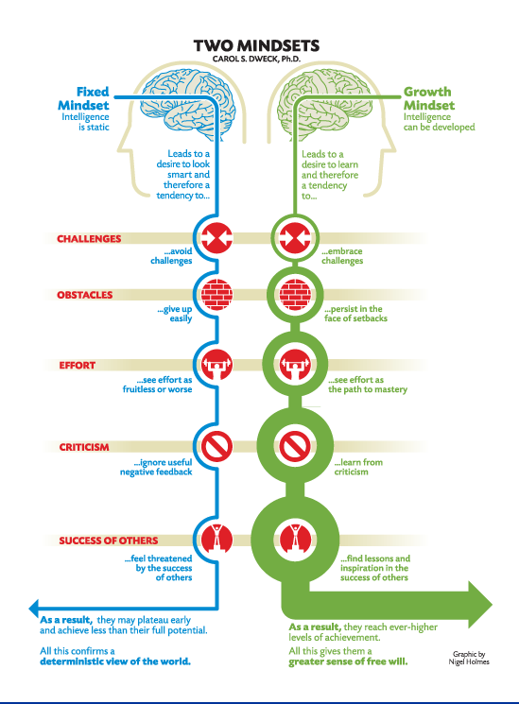
Two Mindsets Graphic by Carol Dweck

Slide 28
Why It Matters in Digital Acquisition
Two Mindset Shifts to Cultivate:
Perspective on risk Step outside your comfort zone to explore new, better ways of doing things.
Embracing failure Treat failure as a critical part of the learning and innovation process.
Notes:
Speaker Notes:
Digital acquisition is inherently about change—whether you’re advocating for modular contracting, user-centered design, or Agile practices. These are new approaches for many agencies, and you’ll face skepticism. Shifting your own mindset—and encouraging others to do the same—is what will help you lead change from within.
Examples:
NASA applauded failed launches as part of risk-taking culture
Pixar reframed failure as a step toward better storytelling

Slide 29
Wellness Rituals
Embrace failure as a sign of growth—“buy small, miss small.”
High performance = caring for body, emotions, mind, and spirit (purpose).
Small, repeatable rituals enhance resilience and recovery.
In stress: routines slip, but reclaiming them improves focus and creativity.
Support systems matter—lean on others when setbacks hit.
Build resilience by starting 1 small wellness ritual/week.
Notes:
Speaker Notes:
We all experience setbacks—especially when we’re leading change or trying something new. And if you're not failing once in a while, you might not be taking enough risk. Just like elite athletes, high-performing professionals must care for their whole selves—not just their minds.
Jim Loehr and Tony Schwartz’s research calls this the “High Performance Pyramid,” emphasizing balance across physical, emotional, mental, and spiritual well-being. “Spiritual,” in this case, means feeling connected to purpose—whether that's family, nature, or a mission you care about.
What helps most are small rituals—like daily walks, gratitude journaling, weekly check-ins with a mentor, or time set aside for creative thinking. These low-effort actions, done consistently, build resilience.
So what can you do starting this week? Try adding one ritual for each area—start small, make it doable, and turn it into a habit. That way, when things get hard, you already have the practices in place to help you bounce back stronger.

Slide 30
Analyze Where the “No” Came From
Hearing “no” means assess and adapt.
Watch for cognitive traps:
Mindreading
Overgeneralizing
Confirmation bias
Emotional reasoning
Revisit your prep: Did your message align with their data or viewpoint?
Use the Ladder of Inference to reflect on how conclusions were drawn.
Notes:
Speaker Notes:
Getting a “no” can sting—but it’s not the end of the road. What matters next is how you respond. This is where your growth mindset and wellness habits come in—they help you stay grounded and clear-headed.
When we’re told no, we often fall into cognitive traps. For example, we might start assuming what the other person was thinking—mindreading. Or we may overgeneralize—“This always happens to me”—which reinforces a fixed mindset.
Pause and reflect. Think about what information the other person was working from. Did you both see the same facts? Did they interpret them differently? The Ladder of Inference is a great tool to unpack how both sides formed their beliefs and decisions. Maybe the “no” wasn’t about your idea—but about a deeper concern you didn’t yet uncover.
Your job now is to stay curious, not defensive—and use what you’ve learned to adapt your next approach.

Slide 31
Should I Fight This Battle? Or Adjust My Approach?
Understand where the “no” came from.
Ask: Could this issue harm the mission if left unaddressed?
Identify risks, timing, and conditions.
Advance change incrementally while maintaining relationships.
Notes:
Speaker Notes:
Now that you've analyzed the “no,” it's time to decide—should you push forward, or adapt your approach?
Ask yourself: Is this issue mission-critical? Would ignoring it put your agency at risk?
Also consider timing. Could pushing now damage relationships or your standing? Sometimes it's smarter to wait or pivot.
Don’t forget your role as a networked leader—maintain your connections and move the needle bit by bit. Big change often starts with small wins.

Slide 32
Meeting Teams Where They Are
Don’t Throw Out the RFQ
You’re brought in to support a long-developed RFQ.
It doesn’t align with Agile best practices.
Team is excited about their work.
Don’t discard—adapt, tweak, protect, and move forward.
Notes:
Speaker Notes:
Picture this: You’re asked to support a team that’s spent months on a 100-page RFQ that isn’t truly Agile.
Your instinct may be to start over—but that could damage morale and working relationships.
Instead, adapt what exists. Insert safeguards. Keep the team’s energy up while steering in the right direction.
This is a great example of incremental change that protects the mission and honors the team’s efforts.

Slide 33
Adjust Your Approach to Make It Winnable
What’s the right message for your audience?
What tradeoffs can you offer?
Can a small win build toward bigger change?
Refer back to your Change & Innovation Readiness Survey.
Notes:
Speaker Notes:
Sometimes the battle is worth it—but it needs a different approach.
Act like a consultant: reframe the message, tailor it to the audience, and focus on small, doable wins.
Use your Change Readiness Survey to judge how much your agency can absorb.
If Agile is brand-new, maybe a small task order is a better start than a sweeping rollout.
Incremental change keeps you strategic—and makes long-term success possible.

Slide 34
Activity: Discussion
Think of a situation in your agency where your ideal vision clashed with an existing approach. How could you have adapted your strategy to make progress without losing momentum or relationships?
Notes:
Speaker Notes:
Now let’s take a few minutes to reflect on this in the context of your own agency. Think about a time when you had a clear vision for change—maybe it was introducing a new digital procurement strategy or shifting to Agile—and it didn’t align with what your team or leadership was used to.
Instead of focusing on what didn’t go as planned, focus on what you might have done—or still could do—to make your approach more effective.
Could you have adjusted your timing?
Could you have involved a different stakeholder earlier in the process?
Could you have reframed your ask to align better with their priorities?
Let’s aim to share both the challenge and one idea for a more ‘winnable’ path forward—small steps you could take that respect the status quo while still nudging it forward.

Slide 35
What to Do When You’re Told No – Framework in Action
Notes:
Speaker Notes:
Welcome to this module where we explore how to navigate situations where your ideas or proposals are met with resistance. We'll walk through a scenario and apply the framework we just learned to analyze the "no" and adjust our approach.

Slide 36
Scenario: The "No" You Didn't Expect
You're working with a technical team on a solicitation. They recently faced public scrutiny due to IT failures and are extremely risk-averse. You propose an Agile-based contract.
The reaction? Resistance.
Notes:
Speaker Notes: Let’s ground this in a real-world scenario. The technical team is nervous. You walk in with enthusiasm and a solid solution, but it falls flat. What happened? We’re going to dissect this using what you now know about influence, mindset, and human behavior.

Slide 37
Part 1: Analyze the "No"
Your expert power may have come off as dismissive.
Change sounded big and scary.
You lacked a trust-based relationship with the team.
Key Biases:
Availability Bias
Representativeness Bias
Theory in Action:
System Justification Theory
Notes:
Speaker Notes: You likely triggered psychological resistance. By making the current way sound wrong and offering a big solution too quickly, they shut down. Availability bias made them think of recent failures. Representativeness bias made your approach seem too far removed from what they know.

Slide 38
Knowledge Check
Part 1: What Else Was Driving the "No"?
Select 2 responses that apply.
[ ] The team sees a problem but is resistant to change it (system justification).
[ ] Fear of another failure leads to risk-aversion.
[ ] They didn’t trust you because you didn’t lead with your credentials.

Slide 39
Knowledge Check
Part 1: What Else Was Driving the "No"?
Select 2 responses that apply.
[✅] The team sees a problem but is resistant to change it (system justification).
[✅] Fear of another failure leads to risk-aversion.
[❌] They didn’t trust you because you didn’t lead with your credentials.
Notes:
Speaker Notes: The correct answers show how internal fears and psychological dynamics play a role. It’s not just about data or the "rightness" of your idea. Understanding their mindset is crucial.

Slide 40
Part 2: How Might I Adjust My Approach?
Start small.
Work with a trusted team member.
Frame as a pilot or test.
Position it as a low-risk experiment.
Notes:
Speaker Notes: Rather than going big, go incremental. Find one small, non-threatening part of the solicitation to test the Agile method. Collaborate with someone they trust. This reduces perceived risk and builds buy-in gradually.

Slide 41
Knowledge Check - What Should You Do Next?
Choose the best next step.
[ ] Send them more info and examples.
[ ] Wait for things to settle, then reengage.
[ ] Propose one small pilot task, co-presented by a trusted colleague.

Slide 42
Knowledge Check - What Should You Do Next?
Choose the best next step.
[❌] Send them more info and examples.
[❌] Wait for things to settle, then reengage.
[✅] Propose one small pilot task, co-presented by a trusted colleague.
Notes:
Speaker Notes: The best way forward is to meet them where they are. Show them a tangible, low-risk way to engage. Co-own the idea with someone they already respect.

Slide 43
What We Learned
"No" often stems from fear, bias, or timing.
Analyze the cause before reacting.
Start small and build trust.
Use relationships and low-risk pilots to move forward.
Notes:
Speaker Notes:
When you hit resistance, don’t shut down. Step back, analyze the why, and adjust your approach. Influence is an art. Small, strategic moves can lead to big change over time.

Slide 44
Telling Your Procurement Story
Notes:
Speaker Notes:
Digital service procurement is always evolving. What works now may not work later. That’s why sharing your experience—even the missteps—is valuable. It helps others learn, innovate faster, and feel supported. You don’t need to be a great writer; you just need to be honest, clear, and reflective.
As a DITAP graduate, your real-world lessons are gold for other acquisition professionals. Stories bring nuance to technical or policy-heavy work. They provide context and emotion that others remember. Sharing your story is a way to give back and push the field forward.

Slide 45
Why Sharing Matters in Government Procurement
When we share what we’ve learned—especially the hard parts—we:
Make future procurements better
Help others avoid our mistakes
Spread innovative ideas
Build resilience across teams
Notes:
Speaker Notes:
Every project teaches something—through curveballs, deadlines, and relationships. Capture those moments to help the whole ecosystem grow stronger.
When we explain how decisions were made—not just what was done—we help others understand the path, tradeoffs, and thinking involved.

Slide 46
What’s Worth Sharing?
Two types of knowledge:
Explicit (rules, policies, templates)
Tacit (instincts, strategies, workarounds)
Notes:
Speaker Notes:
Tacit knowledge is the gold. That conversation you had, the workaround you used, the way you got buy-in—that’s what others need.

Slide 47
Building a Culture of Sharing
Normalize sharing by:
Learning from mistakes
Encouraging honest conversations
Recognizing contributors
Foster psychological safety
Notes:
Speaker Notes: Creating a sharing culture starts with leadership—but also with each of us. Making space for honest reflection is key.
Reflection Prompt: What would it take to build a sharing culture in your agency?

Slide 48
Blogging Your Procurement Journey
Why blog?
Break down what worked
Share tools/templates
Make your work visible
Process lessons learned
Notes:
Speaker Notes:
Blogging doesn’t have to be polished—just helpful and real. Treat it like explaining something to a peer who missed the meeting.

Slide 49
User-Centered Blogging
Ask yourself:
Who is this for?
What do I want them to learn?
How will it help them?
Tips:
Keep it short (500–800 words).
Use plain language.
Make it accessible.
Notes:
Speaker Notes:
Blogging is just another form of user-centered design. The audience is your colleagues—and you’re helping them work better.

Slide 50
Simple Blog Structure
Use:
Problem – What were you solving?
Solution – What did you try?
Impact – What changed?
End with:
A call to action (try this, share, connect)
Notes:
Speaker Notes: This structure makes it easy to write and easy to read. The goal is clarity, not perfection.
Activity Suggestion: Sketch an outline for a short blog post about something you’ve learned.

Slide 51
Writing a Procurement Case Study
Reflect deeply on strategy and process.
Show the “how,” not just the “what”.
Share lessons that others can apply.
Notes:
Speaker Notes:
Case studies are deeper than blog posts. They walk readers through a full journey—obstacles, pivots, results, and takeaways.

Slide 52
Elements of a Great Case Study
Title – Clear and specific
Summary – Problem, approach, result
Context – Agency, scope, users
Problem – What made this hard?
Solution – What you did and why
Journey – Surprises and pivots
Results – Data and impact
Takeaways – What you’d repeat or change
Call to action – Share or try
Notes:
Speaker Notes: Structure helps readers follow your thinking. Show what worked—but don’t shy away from what didn’t. That’s where real learning happens.

Slide 53
Case Study Tips
Use plain language.
Make it skimmable.
Be real—share challenges.
Include links or templates.
Tell a story with a beginning, middle, and end.
Notes:
Speaker Notes:
You’re not writing a report. You’re telling a story someone can learn from. Aim for usefulness, not polish.

Slide 54
Navigating Disclosure
Be mindful of:
Sensitive info or proprietary data
Ongoing legal or contract obligations
Focus on:
Process improvements
Public benefit
Actionable insights
Notes:
Speaker Notes:
Transparency is powerful, but balance it with care. You can still share great stories without revealing protected info.

Slide 55
“Over-Document Everything”
Good storytelling starts with good records.
Keep audit trails and decision logs.
Document lessons as they happen.
Notes:
Speaker Notes:
Good recordkeeping supports accountability—and makes writing case studies or blogs way easier.

Slide 56
Getting Internal Approval to Publish
Start early – Loop in comms/OGC.
Use plain language – Focus on facts.
Highlight public value – Shared learning.
Ask about templates – Use agency examples.
Be flexible – Open to edits/redactions.
Notes:
Speaker Notes:
Publishing takes time, but it’s doable. Frame it as professional development and mission advancement—not PR.

Slide 57
Wrap-Up & Call to Action
Start small—write a blog post or mini case study.
Reflect and share honestly.
Ask for help if you’re unsure what’s shareable.
Model the culture you want to build.
Notes:
Speaker Notes:
You don’t need to be perfect—just willing to share. The more we open up about what we’re learning, the better we all get.

Slide 58
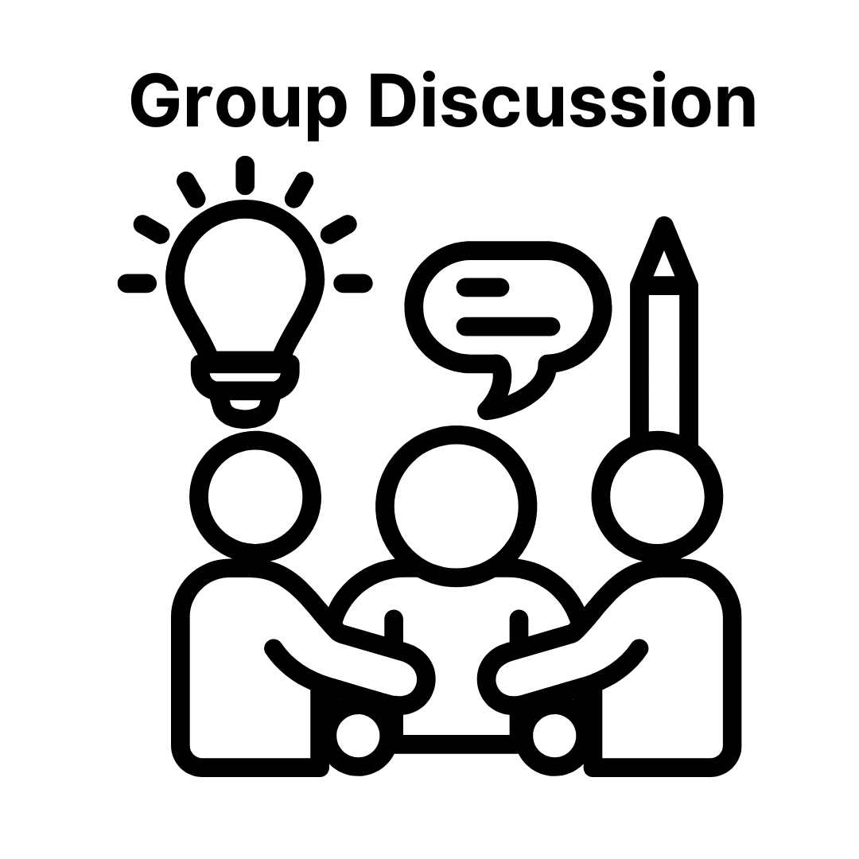
Activity: Group Discussion
What story from your work would help someone else?
What format (blog, case study, short doc) might you use?
Who would benefit from hearing your experience?

Slide 59
Sprint 2
Leading Organizational Change - Continuous Improvement and Scalable Practices

Slide 60
Staying Current and Driving Change - Your Role in Continuous Improvement
Notes:
Speaker Notes:
In this module, we’ll explore what it means to continuously improve in federal acquisition. You’ll reflect on how to stay current with new tools, policies, and practices—and how your growth contributes to real change in your agency.

Slide 61
Why Continuous Learning Matters
Tech and policy are evolving fast.
AI, modernization, digital delivery—things are changing rapidly.
Acquisition is no longer just support—it’s mission-critical.
Staying current helps your agency succeed.
Notes:
Speaker Notes:
We’re in an era of rapid evolution. AI, cybersecurity, and Agile tools are changing how we work. Acquisition professionals must move from reactive to proactive to help their agencies lead in this new environment.

Slide 62
Continuous Learning = Continuous Relevance
Learning is a mindset, not a checkbox.
Seek out trends, tools, policies, and feedback.
Apply what you learn from every project.
Build resilience by being proactive, not reactive.
Notes:
Speaker Notes:
Being current means staying engaged. Read. Reflect. Learn from every experience. This mindset will help you remain effective and resilient even when things shift around you—which they will.

Slide 63
Lead Through Learning
Learning fuels leadership.
Try new contracting strategies.
Test emerging tools and tech.
Mentor others—share what works.
Spark change by modeling it.
Notes:
Speaker Notes:
When you learn, you don’t just grow—you create momentum. Trying something new or sharing a resource might inspire others. Your own growth can move the system forward, one project or conversation at a time.

Slide 64
Activity: Group Discussion
What tools or methods do you use to stay current?
When was the last time you tried something new in acquisition?
How do you model a continuous learning mindset for others?
What learning goal will you set for the next 3 months?
Notes:
Speaker Notes:
Use these prompts to reflect or kick off group conversation. Building a habit of sharing helps normalize continuous learning across your agency.

Slide 65
Staying Current with Emerging Tech and Trends
Tech reshapes how government delivers services.
Acquisition is central to tech adoption.
Your awareness of tech trends strengthens procurement outcomes.
Notes:
Speaker Notes:
Technology is no longer just an IT concern—acquisition professionals are at the center of adopting and enabling innovation in government. In this module, we’ll explore why staying current matters and how to build habits that help you keep up.

Slide 66
Why It Matters
Emerging tech shapes mission delivery.
Tech trends impact how you:
Engage with technical staff
Draft solicitations
Understand industry responses
Structure adaptive contracts
Notes:
Speaker Notes:
Being tech-aware helps you do your job better—even if you’re not a technologist. It gives you the context to draft smarter solicitations, ask the right questions, and match acquisition strategies to what’s possible.

Slide 67
For example: Generative AI and Federal Acquisition
AI is already impacting acquisition work:
Analyzing vendor data for market research
Drafting performance work statements
Creating smarter procurement templates
Innovation moves faster than policy.
Example: The Air Force used AI tools to help draft sections of a cloud services solicitation, speeding up initial content creation and improving consistency.
Notes:
Speaker Notes:
Let’s zoom in on how generative AI is being applied in real-world federal procurement. One example comes from the Department of the Air Force, which used AI-assisted tools to help draft parts of a cloud services solicitation. Instead of writing PWS sections from scratch, the team used AI to create initial drafts based on past solicitations and best practices. This cut down drafting time and created more consistent language across documents.
Generative AI is also being used to analyze vendor data faster and even propose evaluation rubrics aligned with acquisition goals. While human oversight is still essential, AI helps with the heavy lifting of initial drafts—especially in repetitive or data-heavy tasks.

Slide 68
Where to Watch for Tech Trends
FedScoop – Federal tech news
ACT-IAC – Government + industry events
TechFAR Hub – Tech + acquisition guidance
Innovation Labs – DHS, HHS, others
USDS – Tech-forward project examples
Notes:
Speaker Notes:
You don’t need to be in tech to learn from it. These resources offer practical, relevant insights for acquisition professionals navigating innovation.

Slide 69
Learn from Tech Influencers
Follow thought leaders on LinkedIn/Fed News Network.
Join key organizations:
NCMA
Digital Services Coalition
Technologists for the Public Good
Subscribe to:
Federal News Network newsletters
FAI’s Acquisition Today
Notes:
Speaker Notes:
These influencers and organizations can serve as your filter—bringing you relevant updates and smart conversations without information overload.

Slide 70
Make It a Habit
Set a monthly “tech check” reminder.
Join quarterly briefings or virtual events.
Add tech trends to retrospectives.
Block time for learning during less busy weeks.
Notes:
Speaker Notes:
The key is to build a small, consistent habit. You don’t need to become a futurist overnight—just carve out time to stay aware and absorb what’s happening.

Slide 71
Final Thoughts
You don’t need to be a tech expert.
Understanding trends helps you:
Ask better questions
Spot opportunities
Support evolving agency needs
Stay curious, stay relevant.
Notes:
Speaker Notes:
Your value doesn’t come from coding or deep tech expertise—it comes from applying tech-aware thinking to your procurement work. That mindset is what future-ready acquisition looks like.

Slide 72
Discussion – Your Tech Awareness Habits
Reflection questions:
How do I stay informed about tech and acquisition changes?
What challenges have I faced in staying current?
What’s one small habit I could adopt to improve?
Who in my network is good at this—can I learn from them?
Notes:
Speaker Notes:
Let’s wrap up with some reflection/discussion. Continuous improvement starts with awareness—and that starts with asking yourself honest questions.

Slide 73
Why Continuous Improvement Matters
Small improvements build stronger procurement practices.
Reflection helps avoid repeated mistakes.
Consistent learning fosters innovation and agility.
Builds a more effective, user-centered acquisition process.
Notes:
Speaker Notes:
Next, we’ll talk about how to bring a mindset of continuous improvement into your everyday procurement work. You don’t need a big initiative to drive better outcomes—just a habit of reflection, collaboration, and adaptation.
Continuous improvement doesn’t require a full overhaul. In fact, the most meaningful change often comes from the small steps we take—learning after each procurement, refining how we work, and collaborating more intentionally.

Slide 74
Conduct Mini “Lessons Learned”
20–30 min post-procurement reflection
Quick team conversation or 1:1 with program staff
Sample questions:
What went well?
What caused delays or confusion?
Were the requirements clear?
Did industry respond as expected?
Notes:
Speaker Notes:
After each procurement, set aside even just half an hour to reflect. These mini lessons learned don’t need to be formal—but they can reveal valuable insights that improve your next acquisition.

Slide 75
Try an Agile-Style Retrospective
Structured team reflection format:
What went well?
What didn’t?
What we’ll try next time.
Encourages learning and trust
Especially useful for complex or iterative buys
Notes:
Speaker Notes:
Borrow this idea from Agile teams: a retrospective is short and structured. It promotes open, honest feedback and identifies actionable ways to improve—something every procurement team can benefit from.

Slide 76
Tips for Running Retrospectives
Keep it short: 30–45 minutes.
Focus on improvement, not blame.
Assign clear owners for next steps.
Store insights in a shared location.
Notes:
Speaker Notes:
A retrospective only works if people feel safe being honest. Keep the tone constructive, and always link feedback to action. Archiving these sessions builds institutional memory.

Slide 77
Refine Your Tools Over Time
Update templates, checklists, workflows based on lessons learned.
Examples:
Market research templates
Evaluation criteria
Communication milestones
Notes:
Speaker Notes:
What worked well once might not work next time—so iterate. Whether it's a form or a milestone plan, evolve your tools based on lived experience.

Slide 78
Collaborate Early and Often
Work with program staff to shape requirements together.
Co-design communications and timelines.
Share procurement lessons and ask for feedback.
Notes:
Speaker Notes: Improvement starts with partnership. The earlier you collaborate with the program team, the more aligned—and effective—your acquisition process will be.

Slide 79
Document and Share What Works
Write a 1-pager or summary of your lessons.
Share “Top 3 Takeaways” at a team meeting.
Add insights to internal playbooks or guides.
Notes:
Speaker Notes: Don't let your insights stay siloed. Sharing even brief reflections can raise the entire team's learning curve and promote a culture of openness.
Optional Discussion Prompt: What’s one small win or hard lesson you’ve learned recently in a procurement? How could you share that with others?

Slide 80
Final Thoughts
Improvement doesn’t require permission.
Reflect, adapt, and apply small changes.
Over time, this builds stronger outcomes and collaboration.
You can lead improvement—one project at a time.
Notes:
Speaker Notes:
Continuous improvement is a mindset. You already have what you need to make things better: curiosity, experience, and a willingness to reflect. Start small. Share often. That’s how real change happens.

Slide 81
The Case for Creating Practical Guides
Practical guides are the working memory of an organization.
Help public servants act with clarity and confidence.
Provide consistency while allowing flexibility.
Capture real-world experience in usable formats.
Notes:
Speaker Notes:
In fast-changing environments like government, practical guides anchor teams. They simplify complex tasks and allow us to adapt while maintaining quality. They're not rigid instructions—they capture what works and help others repeat it.
Discussion Prompt:
What’s a time you wished there had been a clear guide to help you through a process?

Slide 82
Understanding the Playbook
Originated in military and sports—now used across sectors
Provides organized, strategic approaches
Evolved from rigid manuals to flexible frameworks
Reflects modern organizational need for autonomy and agility
Notes:
Speaker Notes: Playbooks have evolved. Today, they’re less about control and more about empowerment—offering strategic direction while allowing room for creativity. This shift mirrors how modern organizations operate, especially in complex systems like government.
Activity Idea:
Think of a process in your team. What would a playbook for it include?

Slide 83
Playbooks in Tech: Lessons from High-Performing Teams
Encourage MVPs for faster learning
Foster continuous feedback loops
Translate retrospectives into action
Promote a knowledge-sharing culture
Notes:
Speaker Notes: Tech teams use playbooks to operate smarter and faster. These tools help them reflect, learn, and grow. Imagine if public sector teams had the same intentionality around learning and improvement.
Reflection Question:
Which of these practices—MVPs, feedback loops, retros—could benefit your procurement team?

Slide 84
Beyond the Playbook: Types of Practical Guides
Playbooks: Flexible, strategy-focused
Field Guides: Tactical, hands-on
Toolkits: Templates, how-tos, resources
Tip Sheets: Quick-reference and real-time
Workbooks: Reflective and training-driven
Blueprints/Frameworks: Big-picture pathways
Notes:
Speaker Notes: There’s no one-size-fits-all. The most successful teams draw from a range of formats to meet different needs—planning, decision-making, learning, or in-the-moment support.
Activity Prompt:
Choose a challenge your team faces. What format would best support it?
Examples: Playbooks: Strategy-focused and flexible. They outline general approaches and common scenarios, often broken down into "plays."
Tech Challenge Playbook
Digital Services Playbook
Field Guides: Tactical and on-the-ground. Often tailored to a specific audience, use case, or project phase.
TechFAR Hub Field Guides
Digital.gov Human-Centered Design Guide
Toolkits: Resource-rich. Usually include templates, worksheets, and how-tos.
Federal Evaluation Toolkit
Gov.UK’s Open Policy Making Toolkit
Cheat Sheets & Tip Sheets: Lightweight and fast. Designed to be referenced in real time.
CDC’s Tip Sheet for Clear Writing
Workbooks: Interactive and reflection-driven. Useful for trainings and onboarding.
Microsoft’s Citizen Experience Self-Assessment Workbook
Blueprints or Frameworks: High-level guidance with pathways and decision points.
Australia Government’s Digital Service Standard Framework

Slide 85
The Role of Guides in Tech & Government Work
Reflect real-world challenges
Document institutional knowledge
Standardize quality with flexibility
Support user-centered decisions
Accelerate onboarding and transitions
Notes:
Speaker Notes: In government, where change is slow and knowledge can be siloed, guides help surface and preserve what works. They prevent knowledge loss when staff leave and accelerate learning for new team members.
Discussion Prompt:
What critical knowledge in your team isn’t written down but should be?

Slide 86
What Makes a Guide Practical?
Clear purpose: Who and what is it for?
Actionable: Can it be used now?
Plain language: No jargon or acronyms
Context without fluff
Evolves with use and feedback.
Notes:
Speaker Notes:
The best guides are simple and real. They’re built by people doing the work, not consultants or policy writers. Co-creation is key—it ensures relevance and usability.

Slide 87
When to Create a Guide
Repeating the same explanations
Scaling teams or onboarding quickly
Facing avoidable process bottlenecks
Losing institutional memory
Wanting to replicate success
Notes:
Speaker Notes: You don’t need to wait for a formal directive. If something’s hard or confusing, that’s often your cue. If you’ve solved something others struggle with—document it!
Activity Idea:
Have participants list one process that could be improved with a guide.

Slide 88
A Tool for Culture Change
Guides promote equity and clarity
Encourage transparency and iteration
Foster shared ownership
Bridge teams and agencies
Turn informal know-how into collective knowledge
Notes:
Speaker Notes: Creating guides is a culture move. It signals that clarity, shared learning, and improvement are valued. It also democratizes knowledge—so others don’t have to reinvent the wheel.
Reflection Question:
What could your team learn faster if someone wrote it down?

Slide 89
Final Thoughts: Start Small, Keep it Real
Guides are strategic tools—not just documentation.
Support digital transformation and cultural shift.
Start with one useful page.
Co-create, test, and evolve it over time.
Make it shareable and easy to use.
Notes:
Speaker Notes: You don’t need to create a 50-page document. A one-pager or tip sheet that helps someone take the next step with clarity can have a huge impact. Start small, build collaboratively, and keep it alive.
Discussion Prompt:
What’s one piece of advice or guidance you’ve shared more than once? Could that be your first guide?

Slide 90
Exploring Your Role as an Ambassador of Change
Change conversations build influence.
Use that influence to lead change.
This module introduces a change framework.
Focus: Strategies to drive change in each phase.
Notes:
Speaker Notes:
Earlier, you explored how to prepare for and have influence conversations. Now, we’re building on that foundation. This module focuses on your role as an ambassador of change—how you can take your influence and apply it to move your agency forward. We’ll introduce a framework to help you understand the phases of change and walk through practical ways to take action in each.

Slide 91
Why Change Feels Hard
Lack of authority can lead to hesitation.
Risk of blame can make people cautious.
Change disrupts habits and comfort zones.
But avoiding change can cost more in the long run.
Notes:
Speaker Notes:
It’s natural to feel hesitant about initiating change—especially if you’re not the one “in charge.” It’s tempting to play it safe and let others take the lead. But avoiding change can also hold us—and our agencies—back. Remember: small wins are often what build credibility, reduce resistance, and create momentum.

Slide 92
Start Small, Think Big
Start with something easy to adopt.
Small wins build confidence and credibility.
Apply the “buy small, miss small” principle.
Build momentum through iterative change.
Notes:
Speaker Notes:
The most successful change agents don’t start with sweeping overhauls—they start small. Choose something simple, useful, and visible. Demonstrating even minor improvements gives you a track record and helps shift mindsets. This is the same principle behind Agile, MVPs, and modular procurement—small, iterative changes can lead to big transformations.

Slide 93

Optional Activity – Watch & Reflect
TEDx Video Reflection: Tiny Habits for Big Change
As you watch, reflect on:
What’s one message or idea that stood out to you?
What’s one small change you could lead that might have a ripple effect in your team or agency?
What would make that change easier to start or sustain?
Notes:
Speaker Notes:
We invite you to watch a short TEDx talk that explores how major change can happen through small, repeatable habits. As you watch, think about how this concept applies to digital acquisition in your agency. What’s one tiny change you could lead that might snowball into something bigger?
Activity: Tiny Changes, Big Impact
Purpose: Help participants connect the TEDx talk’s message to their real-world work in digital acquisition.
Step 1: Watch the TEDx Talk (17 min)
Before starting the video, frame it with this prompt:
As you watch, consider how the idea of small, repeatable habits leading to major change might apply to digital acquisition in your agency.
Step 2: Guided Reflection (5 min)
After the video, share these questions (on screen or in chat):
What’s one message or idea that stood out to you?
What’s one small change you could lead that might have a ripple effect in your team or agency?
What would make that change easier to start or sustain?
You can have participants jot thoughts down in a shared Google Doc, Jamboard, Padlet, or just privately in their own notes if you're short on tech.
Step 3: Breakout Discussion (10–15 min)
Put participants into small breakout groups (3–4 people) to share:
One small change they’re considering
What barriers they might face
How they might build support or momentum
Encourage them to listen for overlaps or patterns across their responses.
Step 4: Share-Back & Close (5–10 min)
Invite one person from each group to share a key takeaway with the full group—especially any great "tiny changes" that sparked ideas.
Wrap up with this message:
Sustainable transformation in government doesn’t always start with a big, top-down initiative. Sometimes, it begins with a small, intentional action—something you can repeat, model, and build momentum around.

Slide 94
Optional Breakout Discussion: Your First Step Toward Change
What is one small change you could lead this month to improve how your team or agency approaches digital acquisition?
What barriers might you face?
How might you build support or gain momentum?
Notes:
Speaker Notes:
Let’s pause here. Take a moment to jot down one small change you could try out. Maybe it’s simplifying a form, trying a new communication channel, or starting a short feedback session after a buy. Don’t underestimate the impact of these small actions—they’re how change starts.
From the slide before:
Step 3: Breakout Discussion (10–15 min)
Put participants into small breakout groups (3–4 people) to share:
One small change they’re considering
What barriers they might face
How they might build support or momentum
Encourage them to listen for overlaps or patterns across their responses.
Step 4: Share-Back & Close (5–10 min)
Invite one person from each group to share a key takeaway with the full group—especially any great "tiny changes" that sparked ideas.

Slide 95
Introducing the Kotter Model for Change
Kotter’s 8-Step Change Process
Developed by Dr. John Kotter over 40+ years of research
Based on observing successful organizational transformations
Provides a step-by-step framework for leading change
Adaptable to private sector, public sector, and team-level change
Notes:
Speaker Notes:
Let’s look at a proven roadmap for leading change—the Kotter Model. Dr. Kotter developed this 8-step process after decades of observing how successful leaders transform organizations. Whether you're a senior executive or leading from the middle, these steps offer practical guidance for initiating, communicating, and sustaining meaningful change.

Slide 96
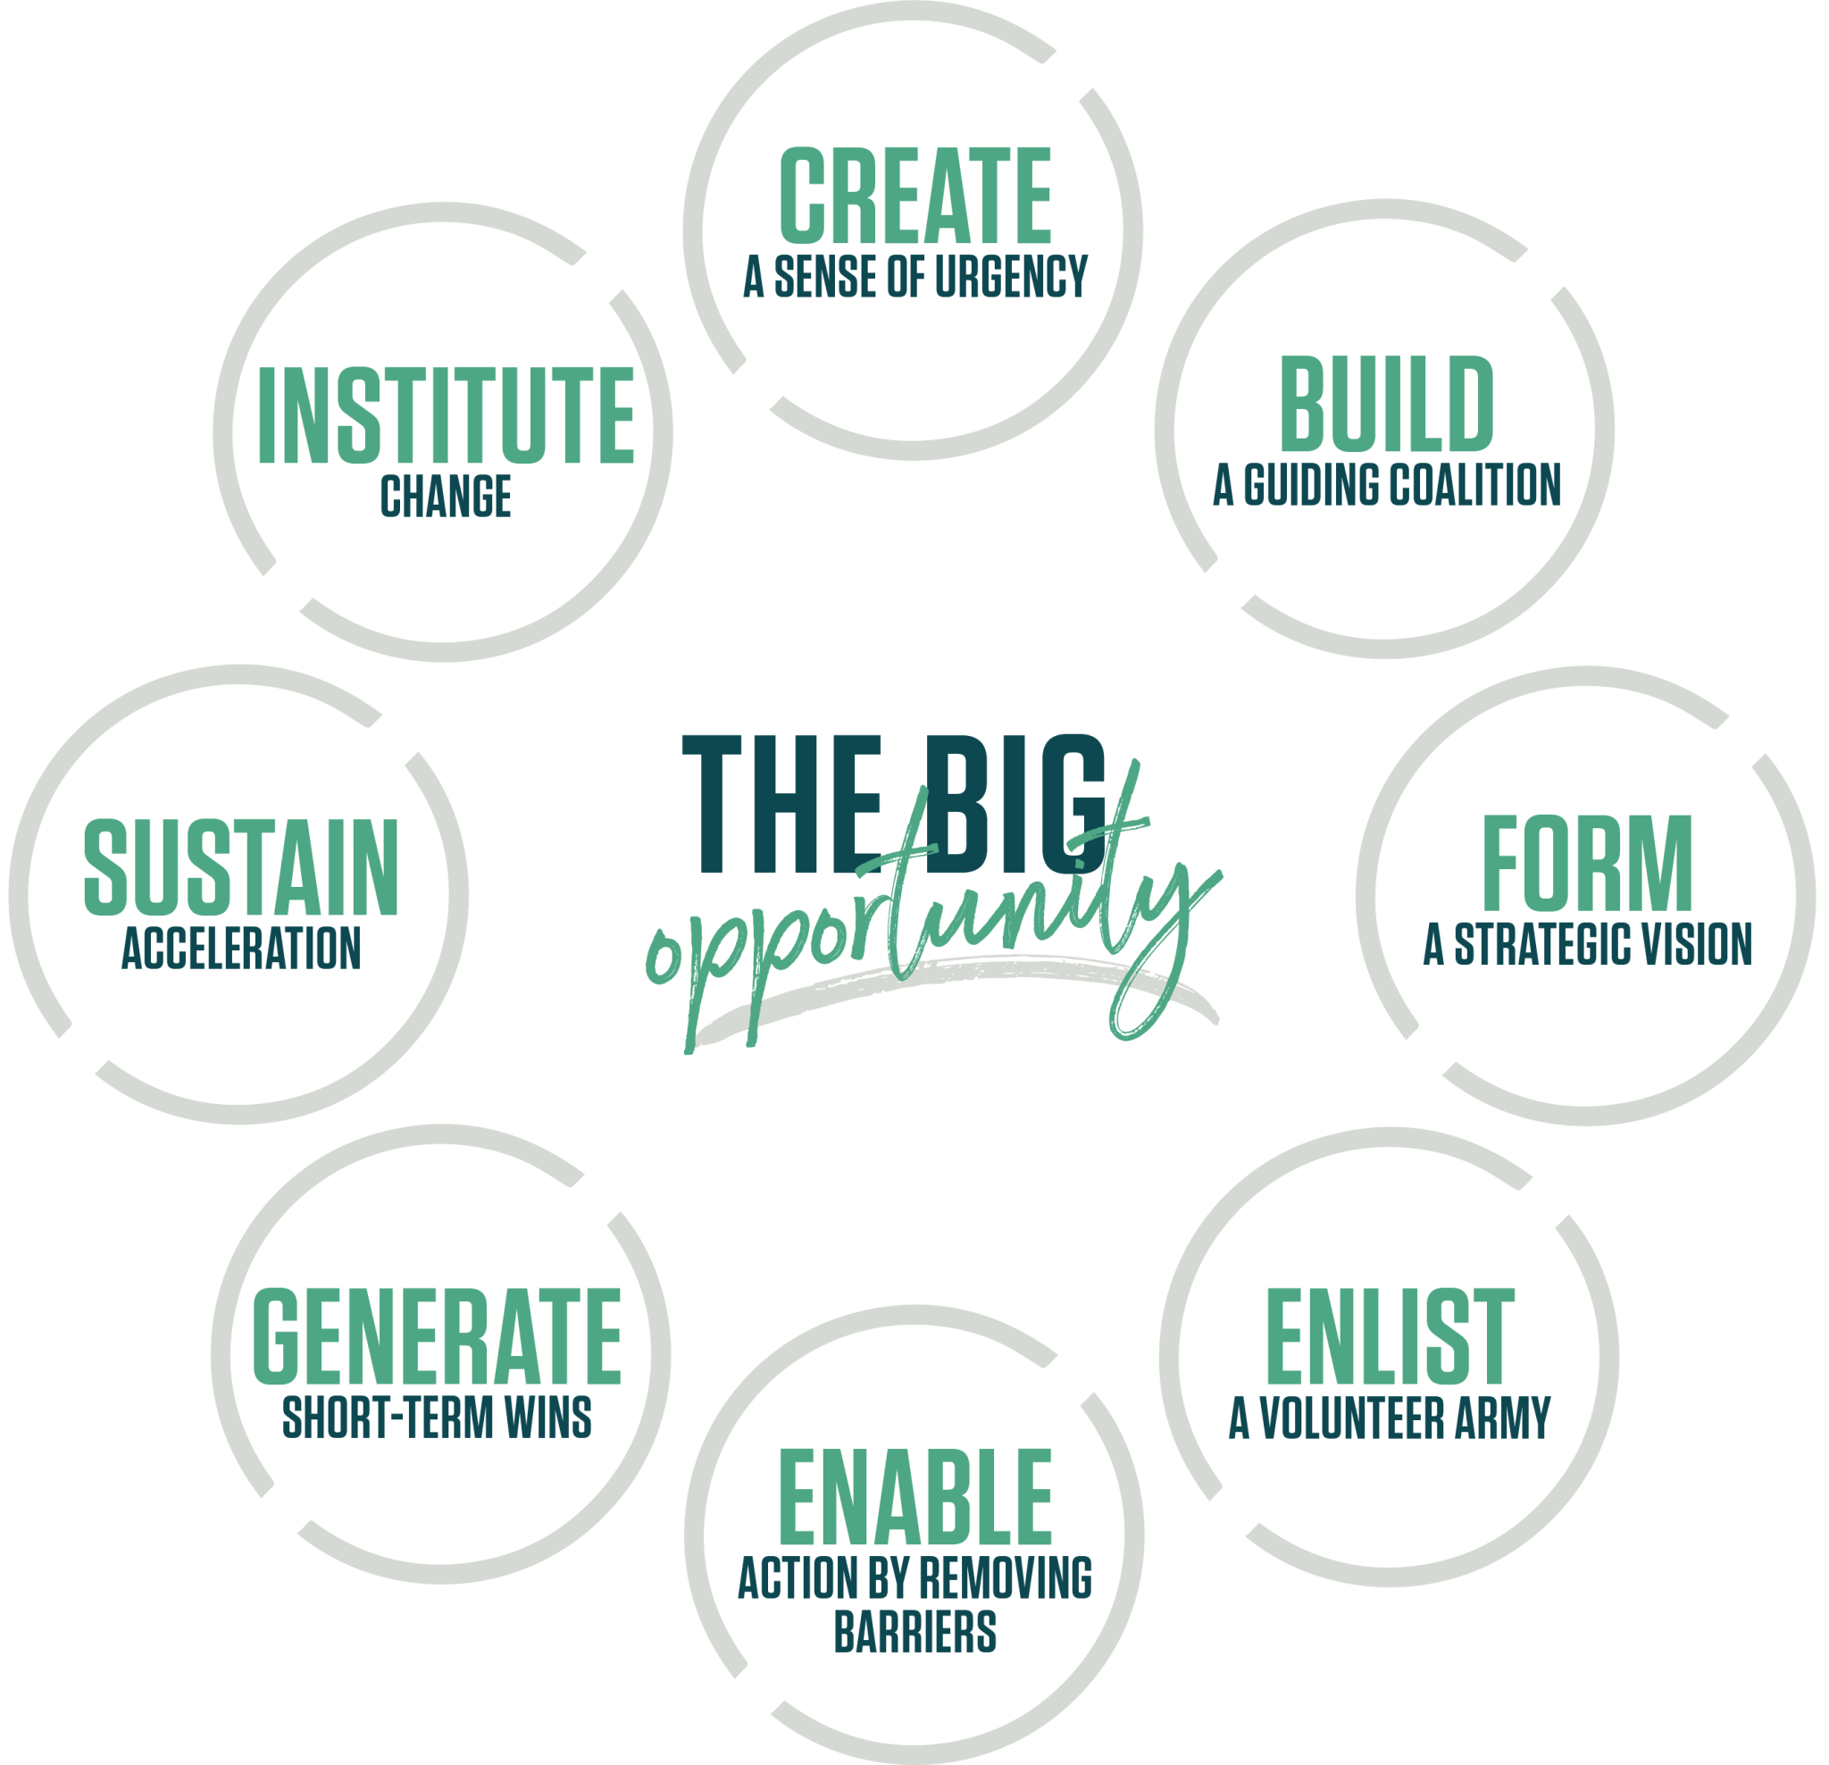
Kotter Methodology 8 steps
Notes:
Source: https://www.kotterinc.com/methodology/8-steps/

Slide 97
Step 1 – Create a Sense of Urgency
Urgency replaces complacency.
"We’ve always done it this way" vs. "The time to act is now"
Complacency can be fueled by past success.
Mid-level leaders play a critical role in building urgency.
Notes:
Speaker Notes:
Step 1 is about creating urgency. Change doesn’t begin without it. Complacency can be dangerous—especially when things seem to be going well. Look at Kodak. They were once dominant in photography but failed to act when digital disrupted their industry. For us in government, the stakes may be different—but the risk of waiting too long is still real. Urgency motivates action and helps you rally support for change—even from the middle of the organization.

Slide 98
Tools to Build Urgency
Revisit the Stakeholder Analysis activity.
Leverage your influence conversation strategies.
Use:
Open-ended questions
Clear, tested messaging
Emotionally intelligent tone
Collaborative framing
Gain commitment by involving others early.
Notes:
Speaker Notes:
You already have tools to build urgency. Go back to your stakeholder mapping. Use what you learned during your influence conversations. Frame your message around your audience’s needs, be clear and relatable, and don’t forget to test your explanation—especially with technical topics. When you bring others into the conversation early, they’re more likely to commit and stay invested.

Slide 99
Step 2 – Build a Guiding Coalition
Key Concepts
Identify and empower change supporters.
Engage stakeholders across functions.
Prevent future bottlenecks.
Ask Yourself
Who influences this process?
Who sees problems and offers solutions?
Who can champion or block your idea?
Notes:
Speaker Notes: In Step 1, you built urgency. Now, Step 2 is about gathering your “team”—your guiding coalition. These are your allies across the organization who will help carry the change forward. Think of this group as your cross-functional support system. They’ll help steer strategy, communicate across silos, and smooth obstacles. Ask yourself: Who has credibility? Who sees the value in this change? Who are your cheerleaders or troubleshooters? Identify them early. Get them involved. The more invested they are, the more they’ll help guide and reinforce the vision with others.

Slide 100
Your Coalition Strategy
Building Your Team
Who are the key stakeholders?
Who can drive or block change?
Who’s missing from the table?
How will you align roles and expectations?
Notes:
Speaker Notes:
Think about your own work. Who touches your acquisition process? Is everyone clear on their role? Have you talked through expectations? Missing this step leads to friction down the road. Some team members will emerge as natural leaders—give them space to guide. Others might be resistant—work to bring them into the fold early. Having these conversations early and often helps ensure that the change effort is sustainable.

Slide 101
Step 3 – Develop a Vision and Strategy to Move Forward
Why Vision Matters
Clarifies direction
Inspires commitment
Aligns decisions
Sustains momentum
Your Vision Should Be:
Clear and future-focused
Emotionally compelling
Grounded in values and goals
Notes:
Speaker Notes:
Now that you’ve built your coalition, it’s time to give them something to rally around—a clear, compelling vision. A good vision describes the world you’re trying to create, why it matters, and how it connects to broader agency goals. It also helps people stay focused when things get tough. Think about how your vision can speak both to logic and emotion—what the change will achieve and why it’s worth the effort.

Slide 102
Reflection Activity – Crafting Your Vision
What future state am I trying to create?
Who benefits from this change—and how?
What will success look like in 6 months? 1 year?
How can I connect this to agency values?
Notes:
Speaker Notes: Take a moment to jot down your vision. Ask yourself: what change do I want to see? Who will it serve? And what makes this effort worth supporting? Think beyond deliverables—what does success look like for your team, your users, and your agency? A well-crafted vision helps make the case for change and keeps people aligned over time.

Slide 103
Step 4 – Communicate the Vision
Paint a compelling, shared picture of the future.
Help people see their role in the new reality.
Show how their contributions matter.
Use emotion and storytelling to inspire action.
Notes:
Speaker Notes:
Now that you’ve crafted a vision, it’s time to communicate it clearly and consistently. A great vision doesn’t just live in a PowerPoint or policy memo—it becomes something people see themselves in. You’re not just asking others to support the change—you’re showing them where they fit and how their actions contribute. Use stories, examples, and emotional appeals to paint a picture they want to be a part of.

Slide 104
Step 5 – Enable Action by Removing Barriers
Identify obstacles slowing down progress.
Equip your team with tools, access, and authority.
Clear the way—then step back.
Celebrate and build on early wins.
Notes:
Speaker Notes:
Once people are on board, don’t let them get bogged down in process or red tape. Your job is to be a force-multiplier—remove the friction so others can move forward. Sometimes that means connecting someone with the right person. Other times it means advocating for a policy exemption or updating outdated templates. Empower your team by removing what’s in their way—but avoid micromanaging. Trust builds momentum. When people have tools, space, and support, they’ll keep pushing the change forward.

Slide 105
Your Role as a Barrier Buster
As a Change Leader:
Identify and address friction points
Anticipate team needs before they arise
Tap your network for solutions
Use your influence to open doors
Notes:
Speaker Notes:
Think about the best manager or leader you’ve worked with—someone who made your work easier, not harder. What did they do? They probably removed blockers, offered support without hovering, and gave you the confidence to act. You can do the same. Start by listening for what's getting in the way. Use your network—cohort peers, internal allies, and tools from this program—to help clear the path. Then get out of the way and let your people do great work.

Slide 106
Reflection Prompt – Build Momentum
What is one barrier your team is currently facing in a change effort?
What tools, access, or support could remove that obstacle?
How can you anticipate your team’s needs in the next phase of your project?
Who else in your coalition can help remove blockers?
Notes:
Speaker Notes:
Before you move into the next phase of change, take a moment to reflect. Think about where your team might stall out. Is it a lack of clarity? Approval delays? Access to tools or templates? Start small. Pick one thing to unblock today. As you build momentum, you’ll show that change is possible—and worth the effort.

Slide 107
Step 6 – Generate Short-Term Wins
Recognize and celebrate small successes.
Wins build morale and credibility.
Use wins to engage skeptics and sustain momentum.
Track, communicate, and celebrate early and often.
Notes:
Speaker Notes:
Short-term wins are fuel for long-term change. They keep energy up, show progress, and can turn skeptics into supporters. Don’t wait for perfection—celebrate progress. Catch people in the act of doing something well. Be specific and meaningful with your praise. And make sure the win is connected to the broader vision—people need to see how each success is building toward the bigger goal. Authenticity matters. Recognition isn’t about checking a box—it’s about inspiring your team to keep going.

Slide 108
Step 7 – Sustain Acceleration
Keep momentum going through adaptation
Avoid stalling out after early wins.
Revisit the vision and refocus regularly.
Continue empowering your team.
Notes:
Speaker Notes:
After the first wave of excitement, energy can fade. That’s where many change efforts lose steam. To keep things moving, you need to continually revisit the “why,” and look for ways to adjust and improve. Help your team overcome fatigue by setting new short-term goals and keeping communication flowing. You’re not starting from scratch—build on the wins, adapt as needed, and stay focused on finishing strong.

Slide 109
What Leaders Can Do to Maintain Momentum
As a Change Leader:
Reinforce purpose in meetings and updates
Set new, visible goals after early wins
Encourage innovation and iteration
Keep recognizing effort and progress
Notes:
Speaker Notes:
Your role is to keep the momentum alive—not by pushing harder, but by pointing toward what’s next and helping the team move with clarity and confidence. Check in regularly on progress. Set micro-goals that continue to show movement. And keep your eye out for innovation opportunities—just because it’s working doesn’t mean it can’t work better.

Slide 110
Step 8 – Institute Change
Make new behaviors part of the culture.
Reinforce change through systems and habits.
Address roadblocks to habit formation.
Create a sustainable path forward.
Notes:
Speaker Notes:
Institutionalizing change means making it part of the way things are done—not just a temporary project. You do this by aligning processes, policies, and recognition with the new behaviors. Think about what systems or rituals will keep this going even after your direct involvement ends. Change sticks when it’s reinforced over time—and when it’s modeled by more than just the leader.

Slide 111
Reflection Questions – Making Change Stick
What are 1–2 small wins you can celebrate in your current work?
What systems, rituals, or tools could help sustain your momentum?
How might you adapt what worked in this module to your own environment?
What would “institutionalizing” change look like in your context?
Notes:
Speaker Notes:
Take a moment to think about your current or upcoming change efforts. What’s working? What could be celebrated? How can you keep the energy going—and eventually make that change part of the fabric of your organization? These aren’t just steps to follow—they’re tools to help you lead lasting, meaningful transformation.

Slide 112
What’s Your Primary Change Style?
Style | Description | How You Might Contribute
Connecter | Builds relationships and trust | - Start a community of practice - Connect stakeholders across silos
Implementer | Turns ideas into action | - Pilot checklists or tools - Lead process changes
Strategist | Sees the big picture | - Guide retrospectives - Align guidance or policy
Challenger | Pushes the boundaries | - Question assumptions - Propose bold shifts
Notes:
Speaker Notes: Let’s talk about how you naturally show up as a change agent. Think back to how you responded to our previous prompts or activities—whether it was reflection, discussion, or decision-making.
Connector. You drive change by building strong relationships and bringing people together. You thrive in collaboration and might be great at starting a working group or connecting teams that don’t usually talk to each other.
Implementer. You’re the one who makes change real—bringing focus, structure, and accountability. You’re great at testing tools, launching pilots, and following through on ideas.
Strategist. You love the systems view—figuring out how to align efforts across processes or policies. You’re probably drawn to guidance development or helping shape repeatable, long-term improvements.
Challenger. You help others question the status quo. Even when it’s uncomfortable, you’re willing to surface risk or push bold ideas that can lead to significant shifts.
Discussion Prompt:
Which style do you most identify with—and where have you seen that show up in your work?
No one style is better than another. In fact, great teams benefit from a mix of all four. Knowing your primary style can help you be more intentional about how you contribute to change—and recognize the strengths others bring.

Slide 113
Create Your Change Contribution Plan
Turn your change style into action.
Small steps = lasting impact.
Use your strengths to guide improvement.
Reflect and jot down responses to 3 prompts.
Notes:
Speaker Notes:
Now that you know your primary change style—Connector, Implementer, Strategist, or Challenger—it’s time to turn that self-awareness into meaningful action. Continuous improvement happens when we make small, intentional choices. This next activity will help you create a simple plan that aligns your strengths with specific contributions you can make in your agency—starting now.

Slide 114
Change Contribution Plan Prompt #1
How will I stay informed about tech and trends?
Choose 1–2 ways to track emerging technology.
Use newsletters, LinkedIn, events, or podcasts.
Tie your learning to your role as a change agent.
Notes:
Example:
“I’ll subscribe to the FAI newsletter and follow two gov tech leaders on LinkedIn.”
Speaker Notes:
Let’s start with staying current. You don’t have to know everything about every new technology—but you do need to keep your eyes open to shifts that affect your agency’s work. What’s one manageable habit you can adopt to stay informed? It could be reading one article a month, joining a virtual briefing, or following industry leaders online.

Slide 115
Change Contribution Plan Prompt #2
What’s one change I’ll lead or support?
Align with your change style (Connector, Implementer, Strategist, Challenger).
Keep it small, focused, and achievable.
Think about what’s needed in your team or agency.
Notes:
Example: “As a Connector, I’ll start a quarterly knowledge-sharing session.”
Speaker Notes: Next, think about one specific change you can lead or support. This doesn’t have to be large-scale—small, visible efforts matter. Maybe it’s launching a new collaboration space or helping streamline a recurring procurement process. Try to tie this back to your change style for a more natural fit.

Slide 116
Change Contribution Plan Prompt #3
What’s one learning habit I’ll strengthen?
Choose a habit to build consistency.
Keep it time-bound and simple.
Aim for something you can sustain.
Notes:
Example: “I’ll set aside 1 hour/month to read a new article or case study.”
Speaker Notes: The best professionals are always learning. What’s one habit you can build to reinforce that growth mindset? Carve out a small amount of time each month—or even each quarter—to explore something new. Keep it low-pressure but consistent. These micro-habits add up over time.

Slide 117
Tip – Make It Real and Share It
Share your plan with a colleague, mentor, or supervisor.
Build in accountability.
Inspire others to act too.
Notes:
Speaker Notes:
Finally, consider sharing your plan with someone else. It could be a colleague, a mentor, or your supervisor. This not only helps keep you accountable but might inspire others to take similar steps. Remember: change doesn’t have to come from the top. When people like you lead by example, the culture shifts.

Slide 118
Questions?

Slide 119
Thank you
Contact information
Feedback survey link (if available)

